Slide 1
Flexbox

Slide 2
Flexbox
Powerful method to distribute items in a direction
Powerful method to align items easily
If there is a container, all items inside will be flexed

Slide 3
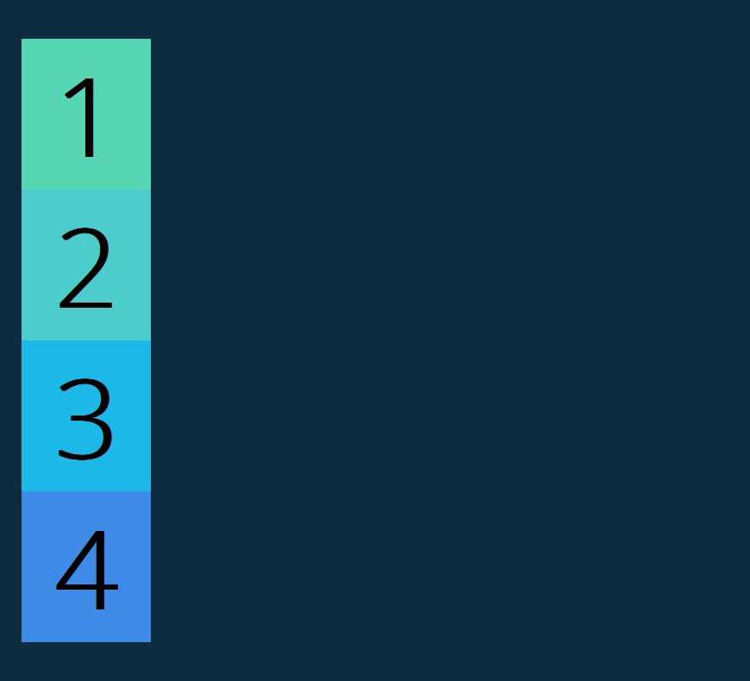

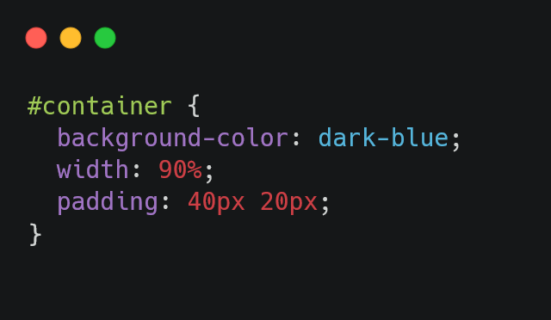
Regular container without flexbox

Slide 4

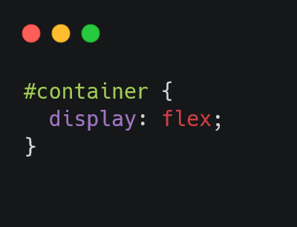
Now, let’s use flexbox

Slide 5
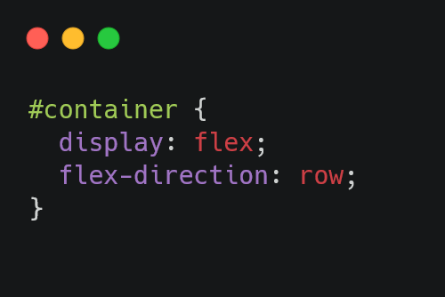
Flex-direction: row (default value)

Slide 6
What can we do with flex-direction: row?

Slide 7
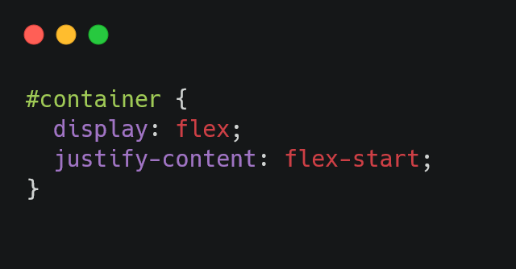
Justify-content: flex-start

Slide 8

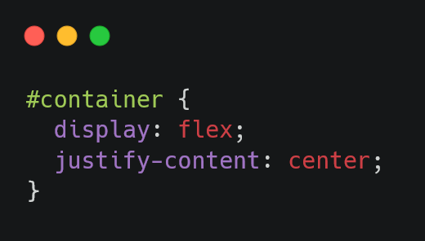
Justify-content: center

Slide 9

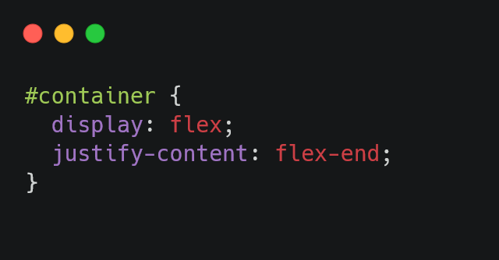
Justify-content: flex-end

Slide 10

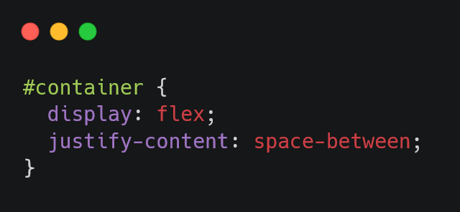
Justify-content: space-between

Slide 11


Justify-content: space-around

Slide 12
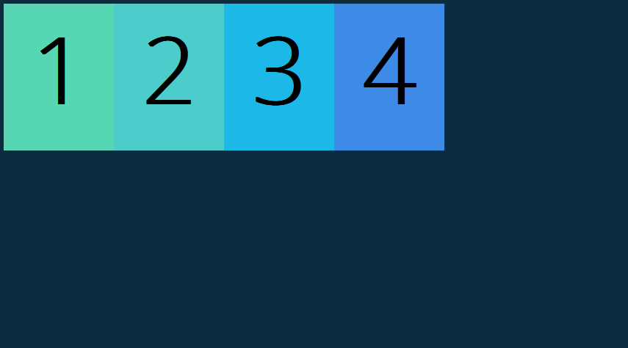
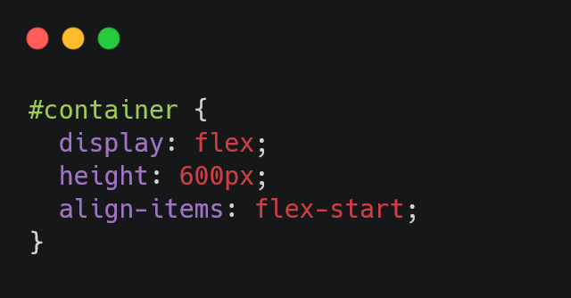
Align-items: flex-start

Slide 13
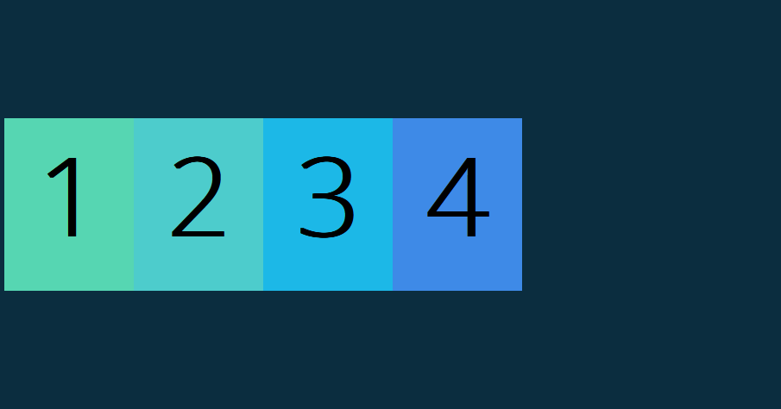
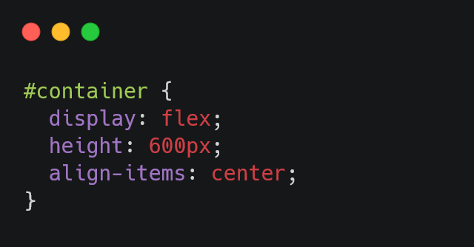
Align-items: center

Slide 14
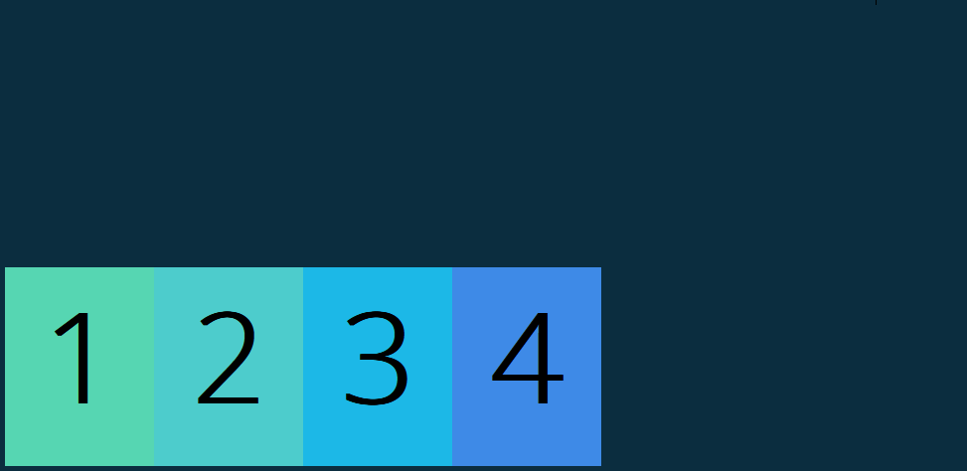
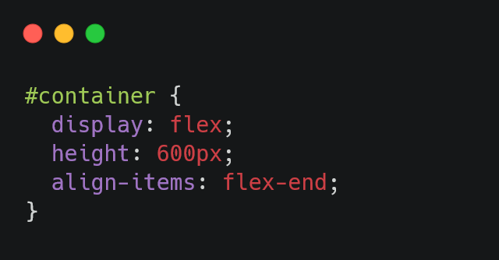
Align-items: flex-end

Slide 15
What else can we do with flexbox?

Slide 16
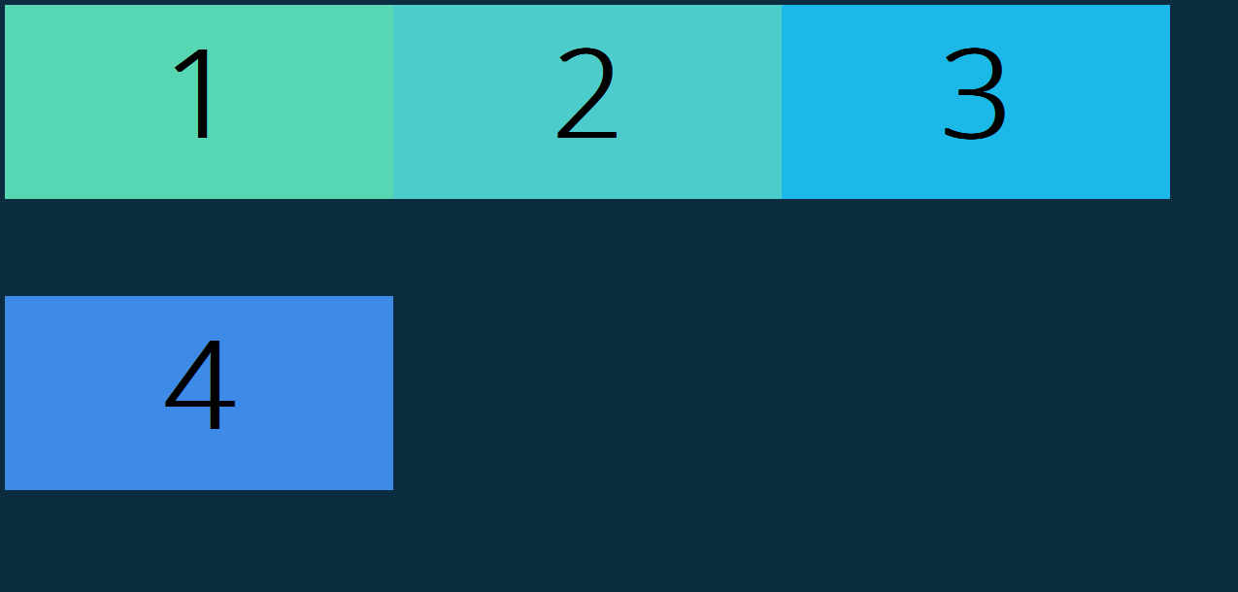
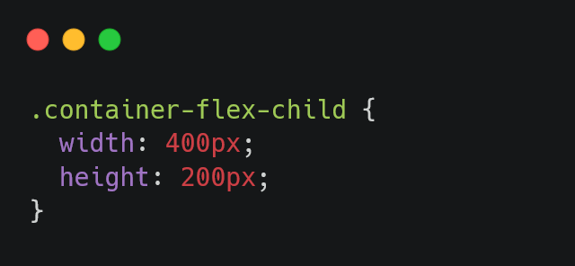
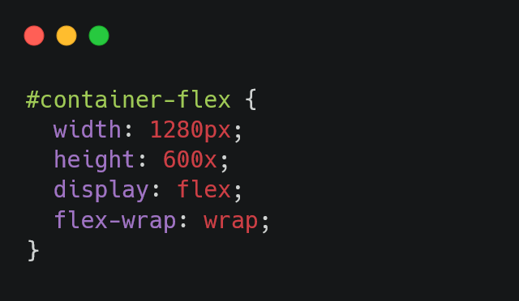
Flex-wrap: wrap

Slide 17
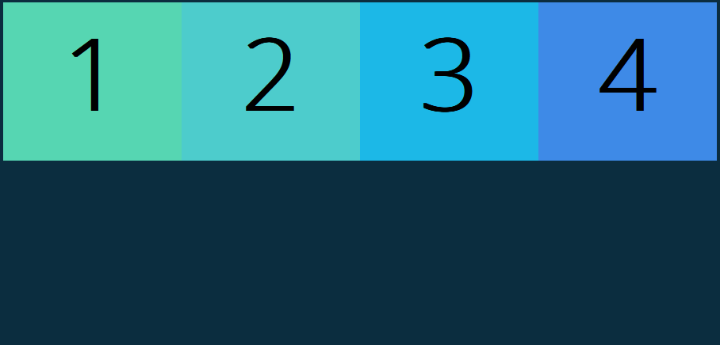
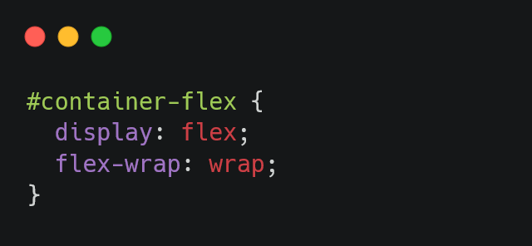
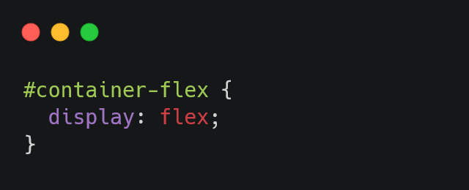
Flex-wrap: wrap
Flex-wrap: nowrap

Slide 18


Flex-grow

Slide 19


Order

Slide 20
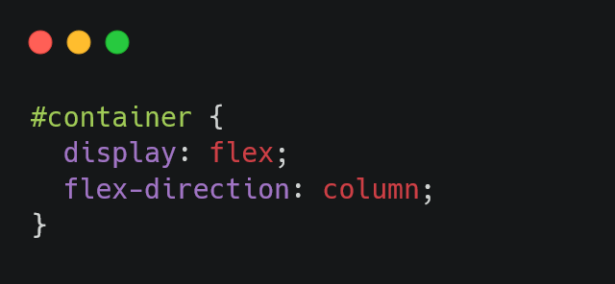
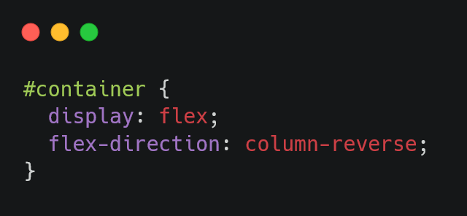
Flex direction

Slide 21
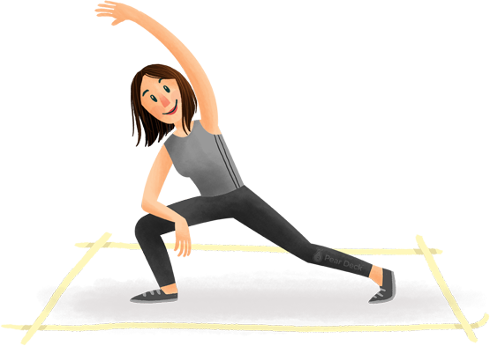
Stretch Break!
Let’s take 5 minutes to stretch

